Slide 1
AXIO for Distribution: WMS Rapid Launch
Use WMS Rapid Launch in a demo and close opportunities faster.
Reach out to Velosio to gain access to Rapid Launch at no cost. insider@velosio.com
Streamline WMS implementation with a preconfigured solution and get to go-live faster.
38 Prepopulated Data Templates
CoPilot
Value
Guarantee successful WMS implementations with prepopulated templates that incorporate distribution best practices
Inbound | Outbound Inventory | Warehouse
Rely on CoPilot virtual agent to assist with populating the templates using Power Automate
Get started with WMS Rapid Launch for $10,000
Average cost for WMS set up of these specific templates ranges from $17,000 - $25,000 or more.

Slide 2
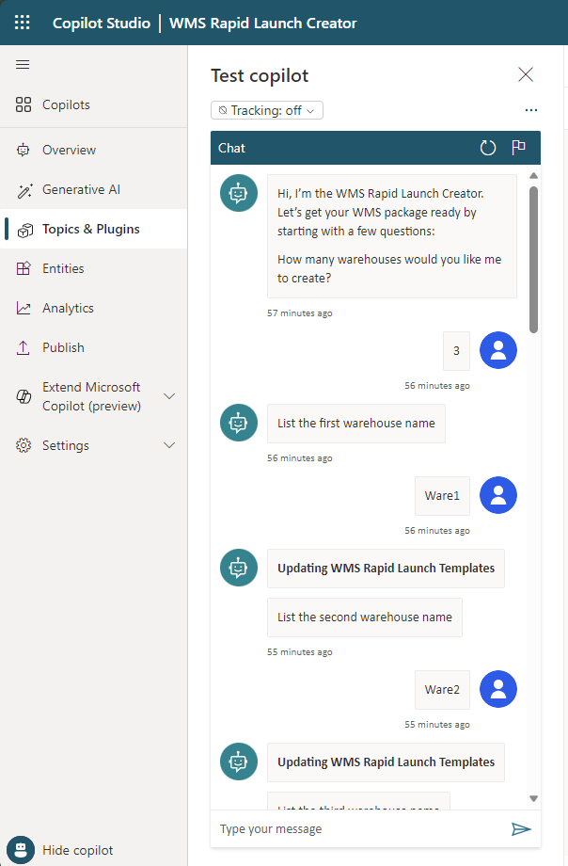
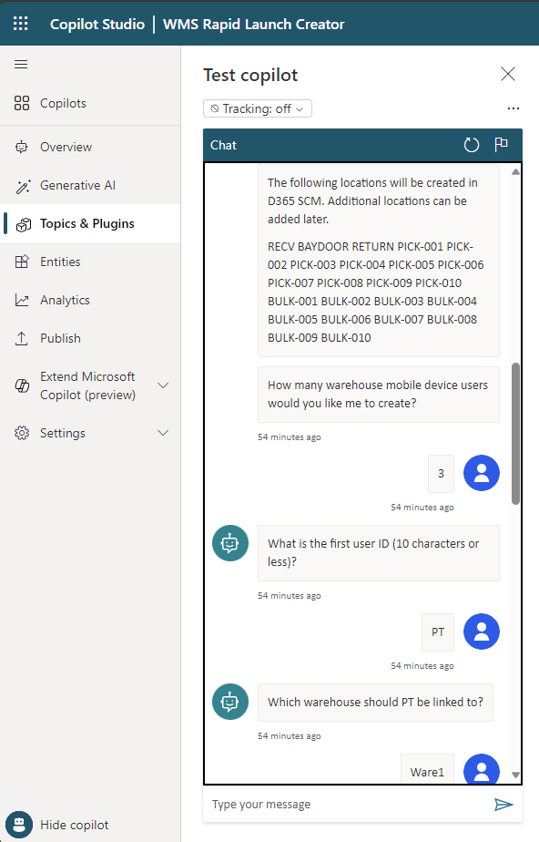
Data Templates
CoPilot
Warehouses
Warehouse Locations
Warehouse Mobile Device Menu
Warehouse Mobile Device Menu Item V4
Inventory Counting Journal Names
Warehouse Wave Templates V4
Warehouse Location Directive Line Actions V3
Warehouse Location Directive Lines
Warehouse Location Directives V3
Warehouse Mobile Device Menu Structure
Warehouse Work Template V3
Wave Template Steps
Warehouse Zones
Warehouse Work Template Lines
Warehouse Zone Groups
Work Classes
Warehouse Mobile Device Menu Item Work Class
Warehouse Mobile Device Menu Item Work Confirmation
Warehouse Work Exceptions
Warehouse Work Pools
Warehouse Location Format Segments
Warehouse Location Profiles
Warehouse Location Formats
Warehouse Location Types
Warehouse Management Parameters V2
Inventory Adjustment Types
Reservation Hierarchy Levels
Reservation Hierarchy
Sites V2
Warehouse Disposition Codes
Warehouse Location Directive Codes
Disposition Code
Inventory Status
Warehouse Mobile Device Users
Warehouse Mobile Device User Assigned Warehouse
Warehouse Workers
Warehouse Location Directive Line Actions V3
Cycle Counting Plan Product Selections V2
Get Started
insider@velosio.com

